Slide 1
Anova Analysis

Slide 2
Classic Anova- Analysis of Variance
‘Classic’ analysis of variance (ANOVA) is a method to compare average (mean) responses to experimental manipulations in controlled environments.
For example, if people who want to loose weight are randomly selected to participate in a weight loss study, each person might be randomly assigned to
a dieting group,
an exercise group and
a "control" group (for which there is no intervention).
The MEAN weight loss for each group is compared to every other group.

Slide 3
Using the scientific method, before any statistical analysis can be conducted, a researcher must generate a guess, or hypothesis about what is going on. The process begins with a Working Hypothesis.
This is a direct statement of the research idea.
For example, a plant biologist may think that plant height may be affected by applying different fertilizers.
So they might say: "Plants with different fertilizers will grow to different heights".
But according to the Popperian Principle of Falsification, we can't conclusively affirm a hypothesis, but we can conclusively negate a hypothesis.
(The core element of a scientific hypothesis is that it must be capability of being proven false.)
So we need to translate the working hypothesis into a null hypothesis that the average height (or mean height) for plants with the different fertilizers will all be the same.
The alternative hypothesis (which the biologist hopes to show) is that they are not all equal, but rather some of the fertilizer treatments have produced plants with different mean heights.
The strength of the data will determine whether the null hypothesis can be rejected with a specified level of confidence.

Slide 4
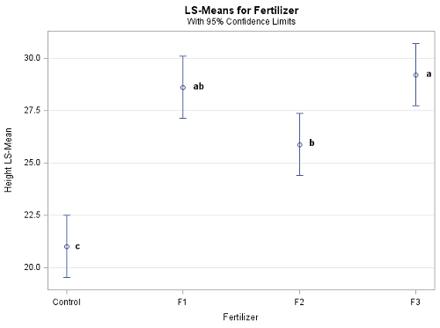
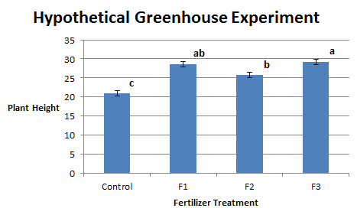
The lower case letters a, ab, b, and c in each of the graphs above? Any two means that do not share the same letter are significantly different after running the ANOVA.

Slide 5
Step 1: State the Null Hypothesis.
The null hypothesis can be thought of as the opposite of the "guess" the research made (in this example the biologist thinks the plant height will be different for the fertilizers).
So the null would be that there will be no difference among the groups of plants. Specifically in more statistical language the null for an ANOVA is that the means are the same.
We state the Null hypothesis as:
H₀: μ1 = μ2 = ⋯⋯ =μk
for k levels of an experimental treatment.
Note: Why do we do this? Why not simply test the working hypothesis directly? The answer lies in the Popperian Principle of Falsification. Karl Popper (a philosopher) discovered that we can’t conclusively confirm a hypothesis, but we can conclusively negate one.
So we set up a Null hypothesis which is effectively the opposite of the working hypothesis. The hope is that based on the strength of the data we will be able to negate or Reject the Null hypothesis and accept an alternative hypothesis.
In other words, we usually see the working hypothesis in H_{A}.

Slide 6
Step 2: State the Alternative Hypothesis
H_{A}: treatment level means not all equal
The reason we state the alternative hypothesis this way is that if the Null is rejected, there are many possibilities.
For example, μ1 ≠ μ2 = ⋯ = μk is one possibility, as is μ1 = μ2 ≠ μ3 = ⋯ =μk.
Many people make the mistake of stating the Alternative Hypothesis as:
μ1 ≠ μ2≠⋯ ≠ μk which says that every mean differs from every other mean.
This is a possibility, but only one of many possibilities. To cover all alternative outcomes, we resort to a verbal statement of ‘not all equal’ and then follow up with mean comparisons to find out where differences among means exist. In our example, this means that fertilizer 1 may result in plants that are really tall, but fertilizers 2, 3 and the plants with no fertilizers don't differ from one another.
A simpler way of thinking about this is that at least one mean is different from all others.

Slide 7
If we look at what can happen in a hypothesis test, we can construct the following contingency table:
It is important to note that we want to set α before the experiment (a-priori) because the Type I error is the more ‘grievous’ error to make.
The typical value of α is 0.05, establishing a 95% confidence level.

Slide 8
Step 4: Collect Data
Remember the importance of recognizing whether data is collected through an experimental design or observational.
Step 5: Calculate a test statistic.
For categorical treatment level means, we use an F statistic, named after R.A. Fisher.
Step 6: Construct Acceptance / Rejection regions.
As with all other test statistics, a threshold (critical) value of F is established. This F value can be obtained from statistical tables, and is referred to as Fcritical or Fα.
This critical value is the minimum value for the test statistic (in this case the F test) for us to be able to reject the null.

Slide 9
F distribution
If the Fcalculated from the data is larger than the Fα, then you are in the Rejection region and you can reject the Null Hypothesis with (1-α) level of confidence.
Note that modern statistical software provides a p-value. The p-value here is the probability of getting an Fcalculated even greater than what you observe. If by chance, the Fcalculated = Fα, then the p-value would exactly equal to α.
With larger Fcalculated values, we move further into the rejection region and the p-value becomes less than α. So the decision rule is as follows:
If the p-value obtained from the ANOVA is less than α, then Reject H₀ and Accept H_{A}.
The F distribution, Fα and the location of Acceptance / Rejection regions are shown in the graph below:

Slide 10



Analysis of Variance
Levels of Stress
Sample
Sample
Sample
Anova Table
Source | df | SS | MS | F
 | 2 | 203.3 | 101.667
 | 12 | 54 | 4.5
 |  | 257.3

Slide 11
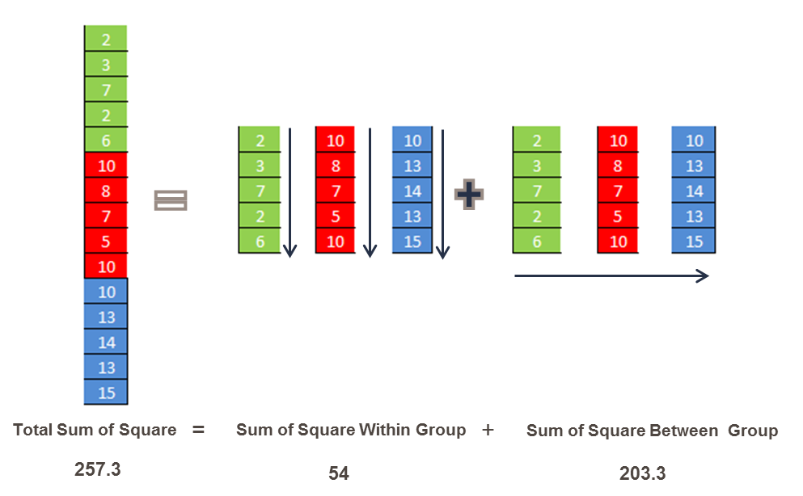
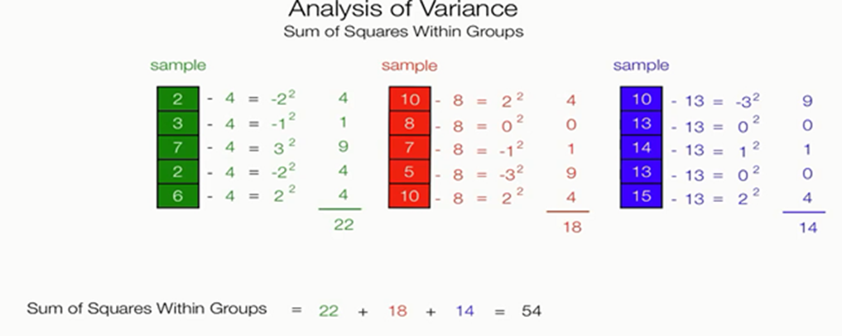
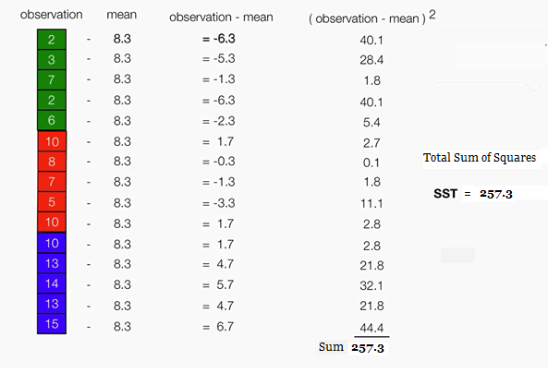
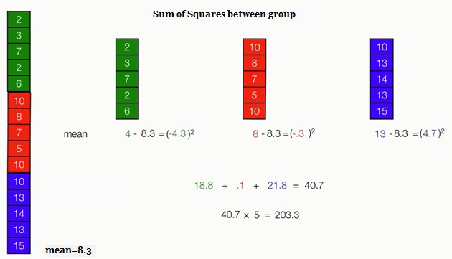
Sum of Squares

Slide 12
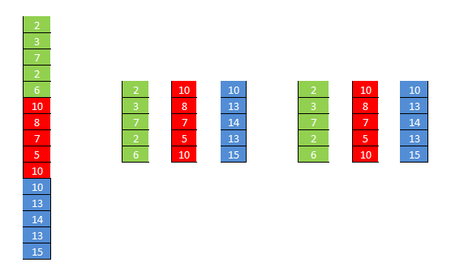
=
+
Total Sum of Square
Sum of Square Within Group
Sum of Square Between Group
257.3
54
203.3

Slide 13
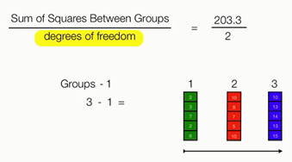
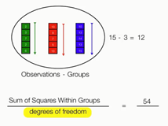
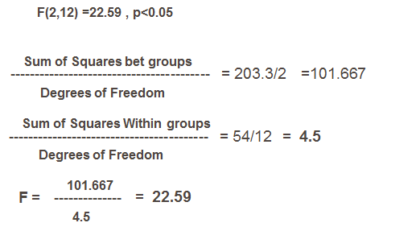
Final Calculations
ANOVA is testing the effect of the treatment relative to the amount of error. In statistics, we call this the partitioning of variability (that due to our treatment and that left over due to random variability in the measurements).

Slide 14
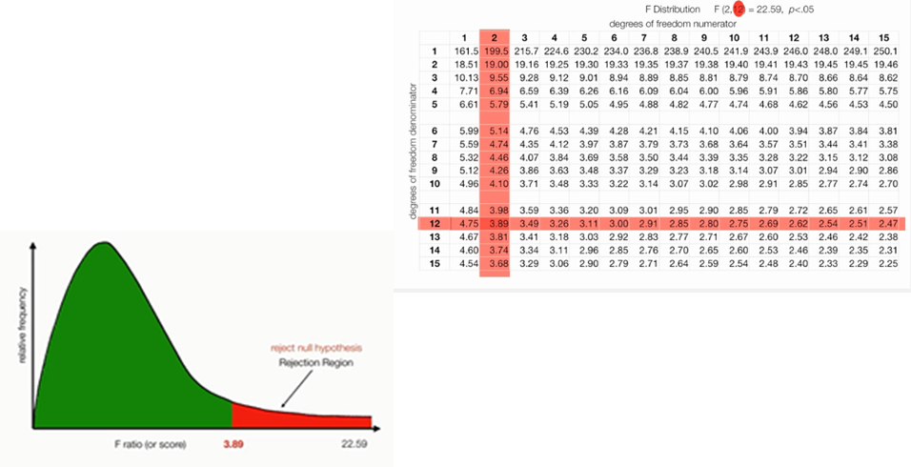
Anova Table
The Fcalculated (22.59) > Fα (3.89) so we Reject H₀ and accept the alternative H_{A}.

Slide 15
Mean Comparison
If (and only if) we reject the Null Hypothesis, we then conclude at least one group is different from one other (importantly we do NOT conclude that all the groups are different).
To answer this question, we can follow up the ANOVA with a mean comparison procedure to find out which means differ from each other and which ones don’t.
You might think we could not bother with the ANOVA and proceed with a series of t tests to compare the groups. While that is intuitively simple, it creates an inflation of type I error. How does this inflation of type I error happen? For a single test,
α=1−(.95)
The probability of committing a type I error (by random chance) for two simultaneous tests follows from the Multiplication Rule for independent events in Probability, Recall that, for two independent events A and B the Probability of A and B both occurring is P(A and B) = P(A) * P(B). So for two tests, we have
α=1−((.95)∗(.95))=0.0975
which is now larger than the α that we original set. For our example, we have 6 comparisons, so α=1−(.95)⁶=0.2649 which is a much larger (inflated) probability of committing a type I error than we originally set.
The multiple comparison procedures compensate for the type I error inflation (although each does so in a slightly different way).

Slide 16
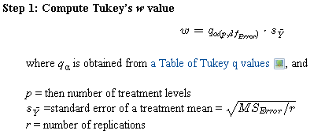

Tukey procedure for Mean comparison
In the Tukey procedure we compute a ‘yardstick’ value based on the MSError and the number of means being compared. If any two means differ by more than the Tukey w value, then they are significantly different.

Slide 17
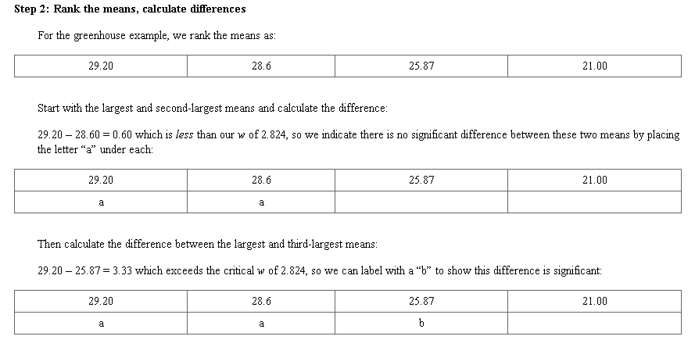
Mean Difference calculation for Plant Treatment example

Slide 18
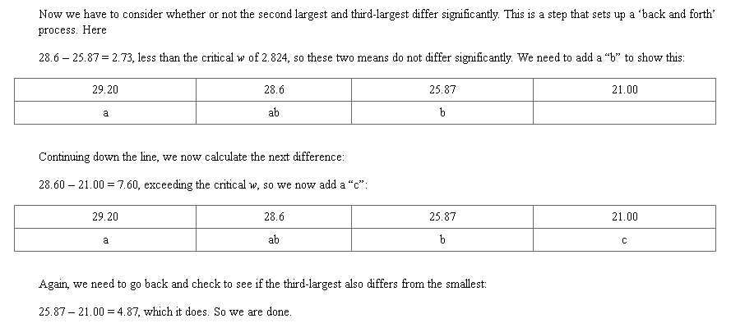
Mean Difference calculation

Slide 19
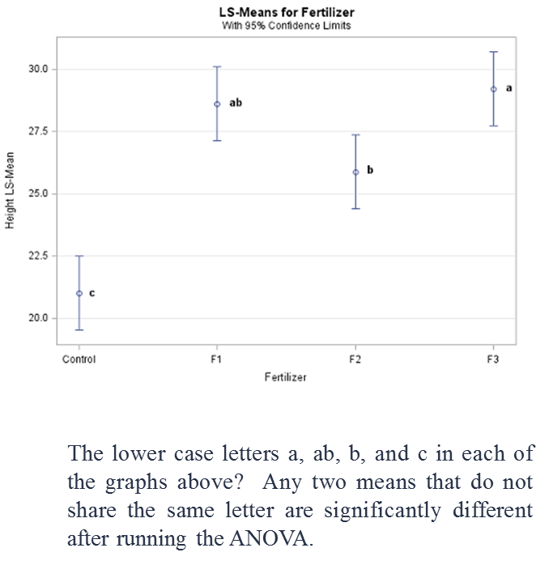
Final Result

Slide 20
Pooled Sample statistics
In statistics, pooled variance (also known as combined, composite, or overall variance) is a method for estimating variance of several different populations when the mean of each population may be different, but one may assume that the variance of each population is the same.
Under the assumption of equal population variances, the pooled sample variance provides a higher precision estimate of variance than the individual sample variances. This higher precision can lead to increased statistical power when used in statistical tests that compare the populations, such as the t-test.
The square-root of a pooled variance estimator is known as a pooled standard deviation (also known as combined, composite, or overall standard deviation).
Consider the following set of data for y obtained at various levels of the independent variable x.
X Y
1 31, 30, 29
2 42, 41, 40, 39
3 31, 28
4 23, 22, 21, 19, 18
5 21, 20, 19, 18,17
X n Ymean Sy2 S
1 3 30.0 1.0 1.0
2 4 40.5 1.67 1.29
3 2 29.5 4.5 2.12
4 5 20.6 4.3 2.07
5 5 19.0 2.5 1.58

Slide 21


Pooled Sample statistics cont..
These statistics represent the variance and standard deviation for each subset of data at the various levels of x. If we can assume that the same phenomena are generating random error at every level of x, the above data can be “pooled” to express a single estimate of variance and standard deviation. In a sense, this suggests finding a mean variance or standard deviation among the five results above. This mean variance is calculated by weighting the individual values with the size of the subset for each level of x. Thus, the pooled variance is defined by

Slide 22
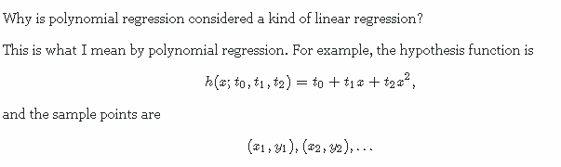
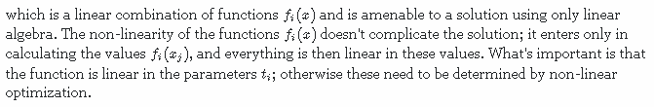
Why is polynomial regression considered a kind of linear regression?
which is a linear combination of functions fi(x)fi(x) and is amenable to a solution using only linear algebra. The non-linearity of the functions fi(x)fi(x) doesn't complicate the solution; it enters only in calculating the values fi(xj)fi(xj), and everything is then linear in these values. What's important is that the function is linear in the parameters titi; otherwise these need to be determined by non-linear optimization.
This is a form of linear regression because it takes the form

Slide 23
Regression Analysis and Anova
In regression analysis you have one variable fixed and you want to know how the variable goes with the other variable.
In analysis of variance you want to know for example: If this specific animal food influences the weight of animals... So one fixed var and the influence on the others...

Slide 24
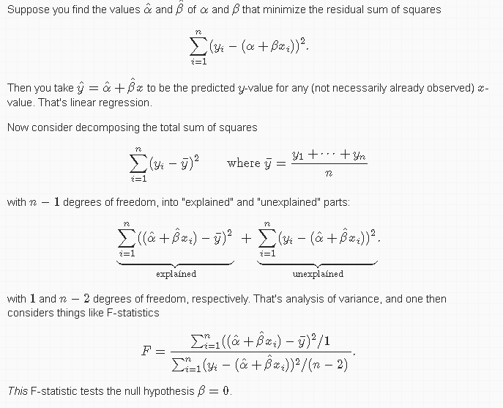

Slide 25
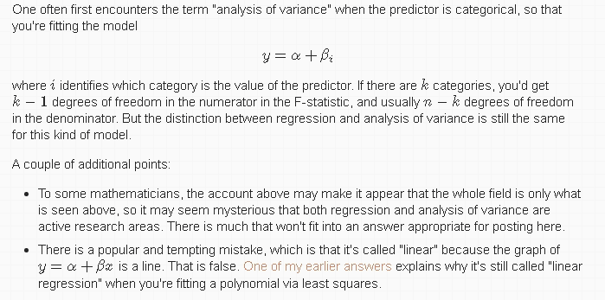

Slide 26
Someone asked me to explain the difference between regression and ANOVA. That's challenging because regression and ANOVA are like the flip sides of the same coin. They are different, but they have more in common that you might think at first glance.
A very simple explanation is that regression is the statistical model that you use to predict a continuous outcome on the basis of one or more continuous predictor variables. In contrast, ANOVA is the statistical model that you use to predict a continuous outcome on the basis of one or more categorical predictor variables. Most people will carve out one big exception to the "one or more categorical variables" statement. If you have a single categorical variable, and it only has two levels (in other words, a binary category), then most people would describe the method/approach as a two-sample t-test. A single categorical predictor with three or more levels or two plus categorical predictor variables with any number of levels would be considered an ANOVA model.
So if you're trying to predict the duration of breastfeeding in weeks using mother's age as a predictor variable, then you would use a regression model. If you are trying to predict the duration of breastfeeding in weeks using mother's marital status (single, married, divorced, widowed), the you would use an ANOVA model. If you are trying to predict the duration of breastfeeding in weeks using prenatal smoking status (smoked during pregnancy, did not smoke during pregnancy), then you would use a two-sample t-test. If you added delivery type (vaginal/c-section) to prenatal smoking status, then the two binary predictor variables would be analyzed using an ANOVA model.
What if you had two predictor variables, one continuous and one categorical? Suppose, for example, that you wanted to predict duration of breastfeeding in weeks using both the mother's age and the delivery type? Is it a regression model, an ANOVA model, or a t-test? Some people would use an entirely new term to describe this model, ANCOVA (Analysis of Covariance). Others might quibble with this terminology. In general, the language of statistics is not as standardized as you might like, and sometimes different people will use different terms for essentially the same model.

Slide 27
But one thing you should always keep in mind is that regression and ANOVA have a lot in common.
First, both models are applicable only when you have a continuous outcome variable. A categorical outcome variable would rule out the use of either a regression model or an ANOVA model.
Second, you can use the regression algorithm, which is based on the principle of least squares, to fit an ANOVA model. You don't have to use the least squares principle because there are other ways to produce the ANOVA model. But because least squares, the basis for regression models, also works for ANOVA models, some people consider the regression model to be the more general model. you can incorporate categorical predictors into a regression model by using indicator variables. An indicator variable is equal to one for a particular category and zero for the remaining categories. If you have a categorical predictor variable with k levels, then you can input k-1 indicator variables (the last indicator is always redundant) in a regression program and effectively get the same results as an ANOVA model.
Third, the concept of partitioning variation into sums of squares (SS) in an ANOVA model also provides a nice way to examine complex regression models. In an ANOVA model, the total variation (total SS) is partitioned into variation between groups (between SS) and variation within groups (within SS). You can do the same sort of thing for a regression model, partitioning total variation into variation due to the model (model SS) and variation unexplained by the model (error SS).
Fourth, regression models and ANOVA models share many of the same diagnostic procedures (procedures used to examine the underlying assumptions). In particular, you can compute residuals in both models and the plots involving those residuals are often very helpful.
In most scientific circles, there are "lumpers" and "splitters." The lumpers try to find common elements in diverse objects and organize things into small groups with many members. The splitters try to create a large number of groups that have fewer members, but have many things in common. If you are a lumper, then you would describe most if not all models involving a continuous outcome as regression models. ANOVA models and even the t-test are quite different from most other regression models, but the lumpers find enough commonality to use a single term for all these models. The splitters are perfectly comfortable with different names and would draw a careful distinction between regression, ANOVA, and t-tests, and would come up with new terms like ANCOVA to handle other situations.
I'm a lumper in my heart, but it's easier during publication time to behave like a splitter. So I use ANOVA in a paper, even though in my heart, I view the ANOVA model much in the same way I treat a regression model. The problem is that the people who make a sharp distinction between regression and ANOVA are more likely to give you a hard time about your publication than the people who view regression and ANOVA as pretty much the same thing.

